Slide 1
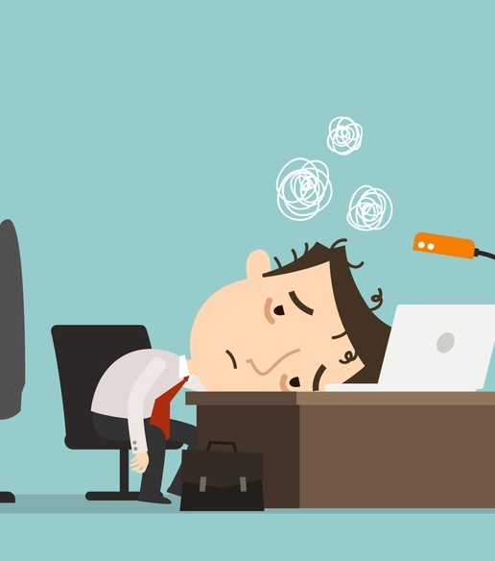
Session III.
Group & Team Theory (cont.)
Handling Stress in Groups

Slide 2
LEARNING OBJECTIVES
By the end of this section, you will be able to:
Identify sources of stress, particularly for college students
Describe the symptoms and effects of chronic stress
List healthy ways of managing stress that fit your current lifestyle

Slide 3
Being in control of your life and having realistic expectations about your day­-to-­day challenges are the keys to stress management, which is perhaps the most important ingredient to living a happy, healthy and rewarding life.
­—Marilu Henner, actress

Slide 4
Causes of Stress
As a student, you’re probably plenty familiar with the experience of stress—a condition characterized by symptoms of physical or emotional tension.
What you may not know is that it’s a natural response of the mind and body to a situation in which a person feels threatened or anxious.

Slide 5
Causes of Stress (cont.)
Strong emotions like fear, sadness, or other symptoms of depression are normal, as long as they are temporary and don’t interfere with daily activities.
If these emotions last too long or cause other problems, it’s a different story:
Stress make you feel overwhelmed and out of control.

Slide 6
Negative stress
Stress can hit you when you least expect it—before a test, after losing a job, or during conflict in a relationship.
While everyone experiences stress at times, a prolonged bout of it can affect your health and ability to cope with life.

Slide 7
Positive Stress
Stress can be positive
For instance, it can help you develop skills needed to manage potentially challenging or threatening situations in life.
For example: preparing for a holiday trip

Slide 8
Signs and Effects of Stress common symptoms of stress:
Disbelief and shock
Tension and irritability
Fear and anxiety about the future
Difficulty making decisions
Being numb to one’s feelings
Loss of interest in normal activities
Loss of appetite (or increased appetite)
Nightmares and recurring thoughts about the event
Anger
Increased use of alcohol and drugs
Sadness and other symptoms of depression
Feeling powerless
Crying
Sleep problems
Headaches, back pains, and stomach problems
Trouble concentrating

Slide 9
Chronic Stress
Including the following:
Anxiety
Depression
Digestive problems
Heart disease
Sleep problems
Weight gain
Memory and concentration impairment
Can impair your immune system and disrupt almost all of your body’s processes, leading to increased risk of numerous health problems

Slide 10

That’s why it’s so important to learn healthy ways of coping with the stressors in your life.

Slide 11
Ways of Managing Stress (6)
The best strategy for managing stress is by taking care of yourself in the following ways:
Avoid drugs and alcohol
Manage your time
Connect socially
Slow down and cut out distractions for a while.
Take care of your health
Find support

Slide 12


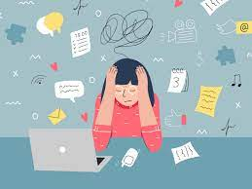
Avoid drugs and alcohol
They may seem to be a temporary fix to feel better
But in the long run they can create more problems and add to your stress - instead of taking it away.

Slide 13
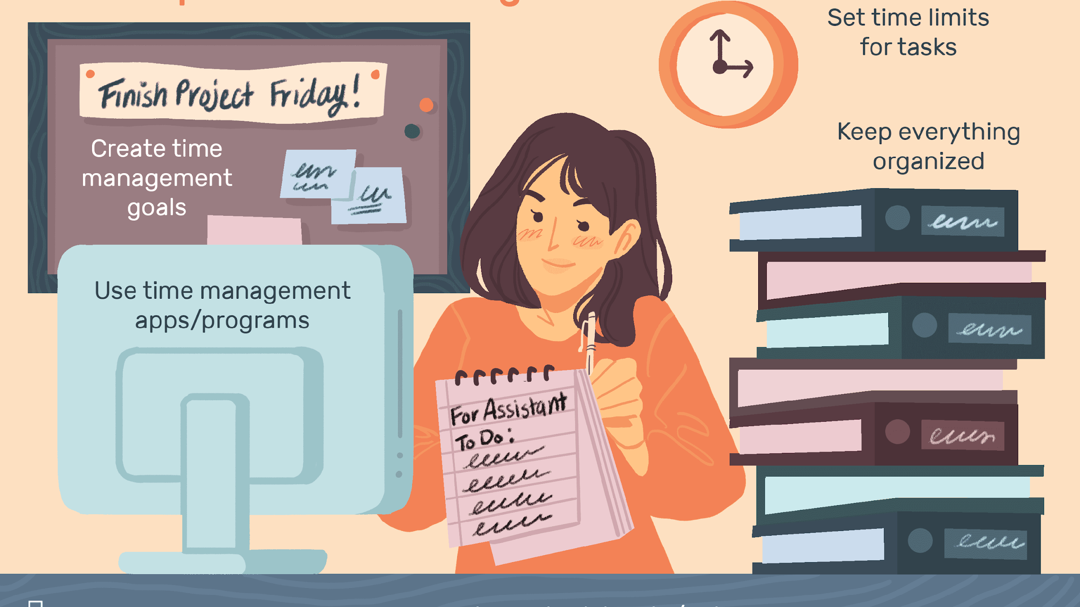
Manage Your Time
Work on prioritizing and scheduling your commitments.
This will help you feel in better control of your life, which, in turn, will mean less stress.

Slide 14

Connect socially
When you feel stressed, it’s easy to isolate yourself.
Try to resist this impulse and stay connected.
Make time to enjoy being with classmates, friends, and family; try to schedule study breaks that you can take with other people.

Slide 15

Slow down and cut out distractions for a while
Take a break from your phone, email, and social media.

Slide 16
Take care of your health
Eat a healthy, well-balanced diet
Exercise regularly
Get plenty of sleep
Try a relaxation technique, such as meditation or yoga, or treat yourself to a massage
Maintain a normal routine

Slide 17
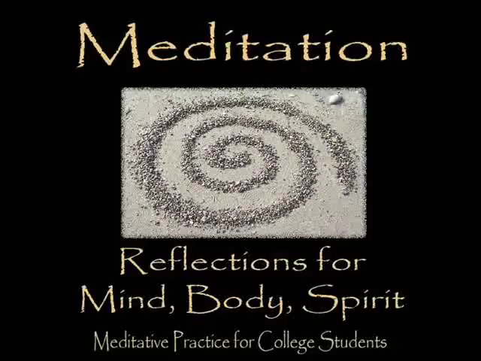
Meditation

Slide 18
Find support
Seek help from a friend, family member, partner, counselor, doctor, or clergy person.
Having a sympathetic listening ear and talking about your problems and stress really can lighten the burden.
Counseling/therapy Center
Hospital
Online counseling
Hotline
Family, Friends, …

Slide 19



For example: Free Counseling service from your university

Slide 20
If the self-care techniques listed above aren’t enough and stress is seriously interfering with your studies or life, don’t be afraid to get help. The student health center and college counselors are both good resources.

Slide 21

Activity: Relaxation

Slide 22


